Slide 1

BC2410, Prescriptive Analytics From Data to Decision
Introduction to Python
Notes:
Hi all,
This PPT introduces you all the basics of python.
Please practice more and be familiar with all the variables, control flow, functions, linear algebra, and file input/output.
You can also practice in websites:
https://www.w3schools.com/python/python_exercises.asp
https://www.w3resource.com/python-exercises/
https://www.practicepython.org/
https://www.geeksforgeeks.org/python-exercises-practice-questions-and-solutions/

Slide 4
Back to LOP Example:
A furniture company makes tables and chairs
Production require wood, finishing labor and carpentry labor.
 | Desk | Table | Chair | Avail.
Revenue | 60 | 30 | 20
Wood | 8 | 6 | 1 | 48
Finish Hrs | 4 | 2 | 1.5 | 20
Carpentry Hrs | 2 | 1.5 | 0.5 | 8

Slide 5
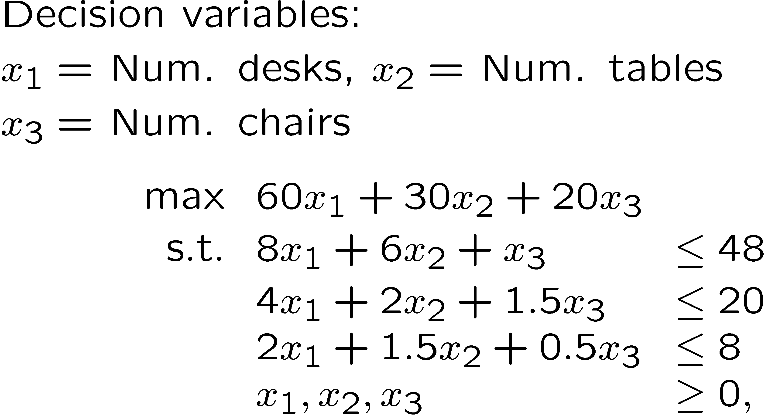
LOP Example:

Slide 6
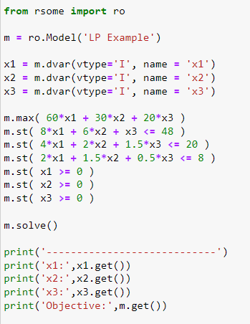
RSOME Python API
Notes:
This model can be easily solved by using RSOME
The python codes are attached below:
# Import package
from rsome import ro
from rsome import grb_solver as grb
# Define model
m = ro.Model('LP Example')
# Decision variables
x1 = m.dvar(vtype='I', name = 'x1')
x2 = m.dvar(vtype='I', name = 'x2')
x3 = m.dvar(vtype='I', name = 'x3')
# Objective
m.max( 60*x1 + 30*x2 + 20*x3 )
#Constraints
m.st( 8*x1 + 6*x2 + x3 <= 48 )
m.st( 4*x1 + 2*x2 + 1.5*x3 <= 20 )
m.st( 2*x1 + 1.5*x2 + 0.5*x3 <= 8 )
m.st( x1 >= 0 )
m.st( x2 >= 0 )
m.st( x3 >= 0 )
# Solve the model and print the solution
m.solve(grb)
print('----------------------------')
print(' Desks:',x1.get()[0],'\n', 'Tables:',x2.get()[0],'\n', 'Chairs:',x3.get()[0])
print(' Maximum profit:',m.get())

Slide 7
Python Basics
Python is an interpreted high-level programming language for general-purpose programming.
Python has a design philosophy that emphasizes code readability, notably using significant whitespace.

Slide 10


Slide 11
Python Basics
Python is an interpreted high-level programming language for general-purpose programming.
Python has a design philosophy that emphasizes code readability, notably using significant whitespace.
It has a large and comprehensive standard library.

Slide 14
Python Basics
Python is an interpreted high-level programming language for general-purpose programming.
Python has a design philosophy that emphasizes code readability, notably using significant whitespace.
It has a large and comprehensive standard library.
More tutorials can be found here:
https://docs.python.org/3.6/tutorial/index.html
https://www.tutorialspoint.com/python3/index.htm
http://cs231n.github.io/python-numpy-tutorial/

Slide 15
Variables and Basic Types

Slide 16
Basic Types
Numbers
int (integers), e.g., -10
float (floating point real values), e.g., -10.0, 32.3+e18
Booleans: Bool, true or false
Strings
A contiguous set of characters represented in the quotation marks. e.g., “Hello World!”

Slide 17
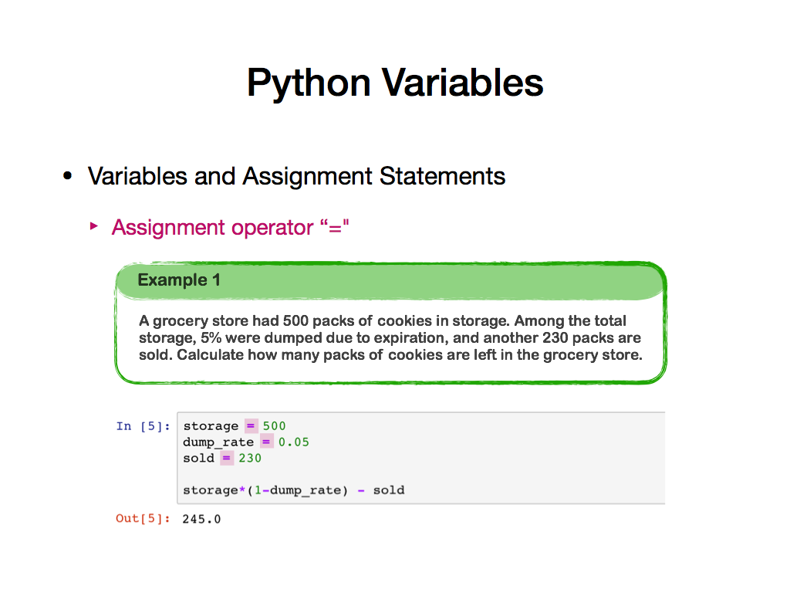

Slide 18
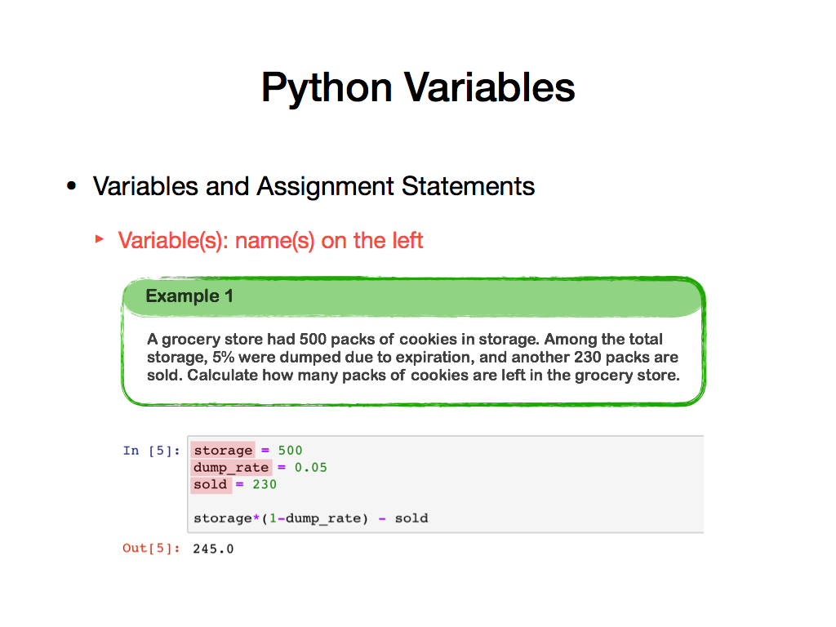

Slide 19
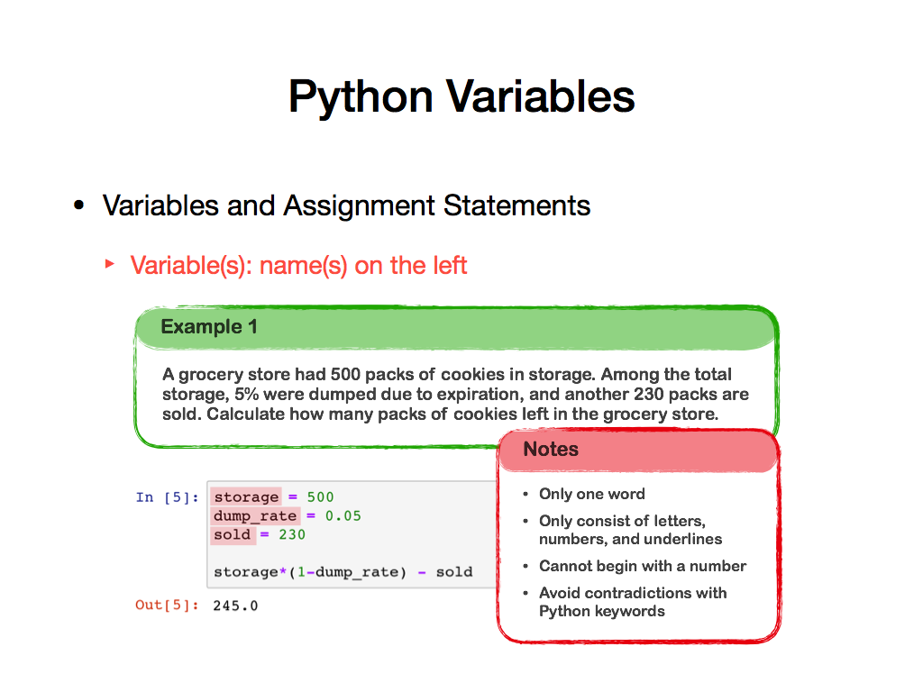

Slide 20
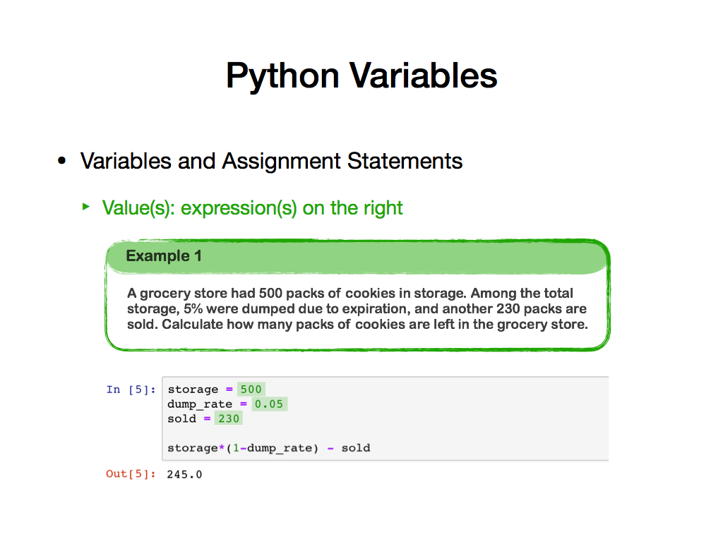

Slide 21
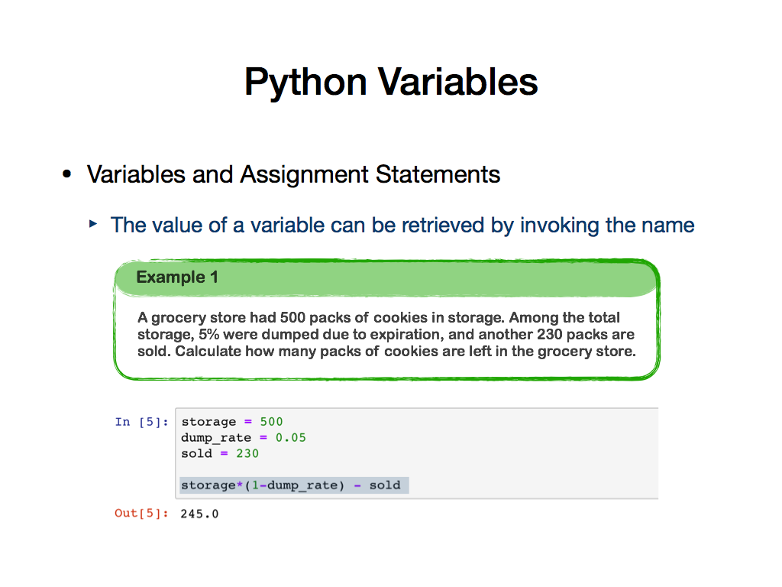

Slide 22
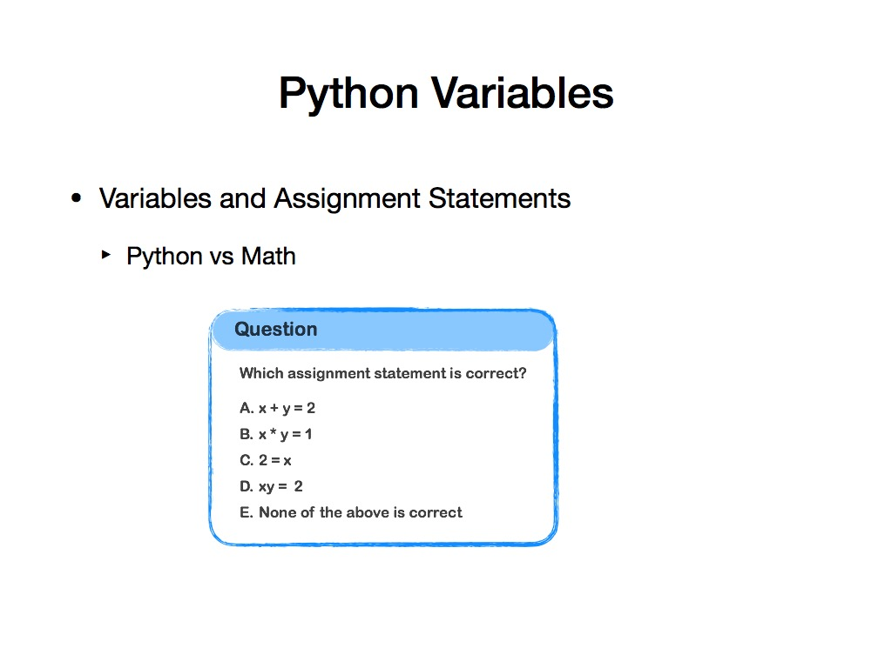

Slide 23
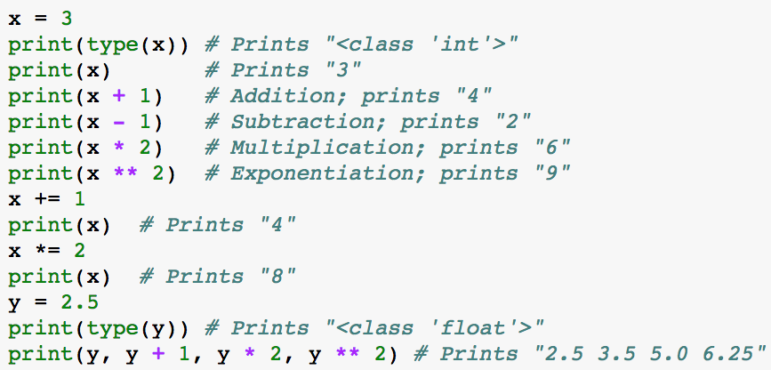
Basic Arithmetic
More examples on basic arithmetic operations

Slide 24
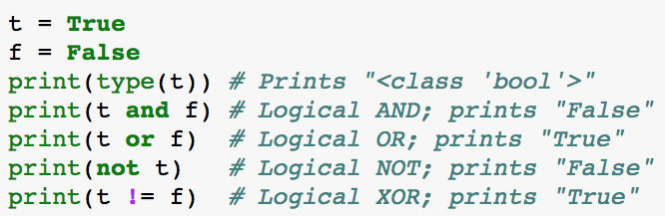
Boolean Variables
Evaluated to True or False
Combine Boolean expression using and, or
Flip Boolean value using not
Membership: use in, not in

Slide 26
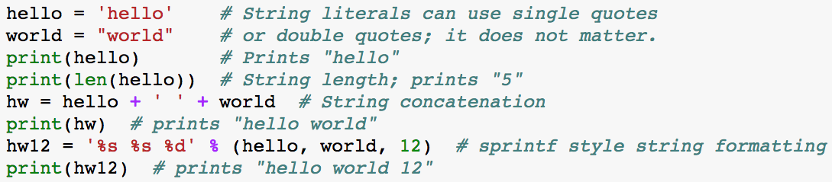
Strings

Slide 27
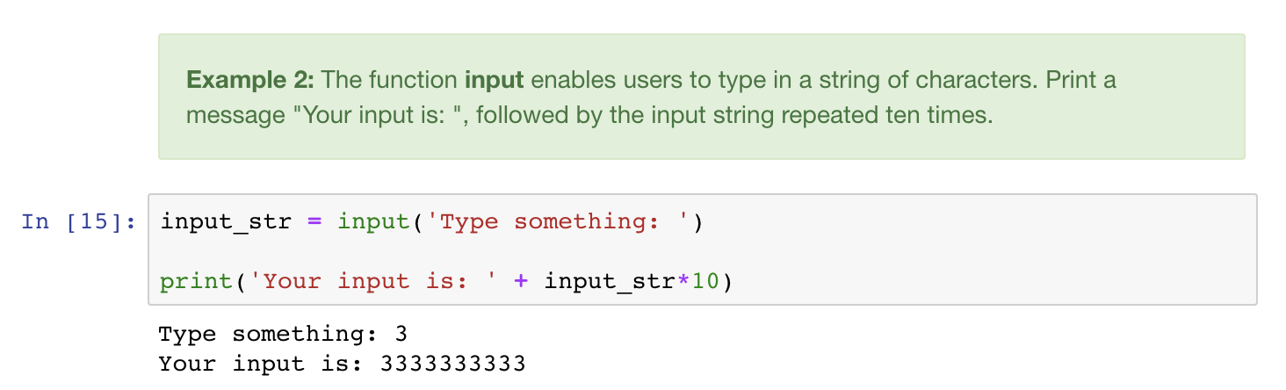
HOW ABOUT MULTIPLYING THE INPUT NUMBER BY TEN?

Slide 28
HOW ABOUT MULTIPLYING THE INPUT NUMBER BY TEN?

Slide 32
Compound Types
List
e.g., [‘abcd’, 786, 2.23, ‘john’, 70.2]
Tuple
e.g., (‘abcd’, 786, 2.23, ‘john’, 70.2)
Dictionary
e.g., {‘cat’: ‘cute’, ‘dog’: ‘furry’}
Set
e.g., {‘cat’, ‘dog’}

Slide 33
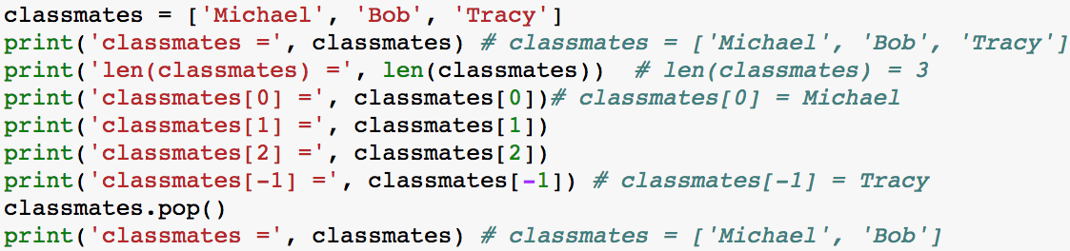
List
A list is the Python equivalent of an array, but is resizeable and can contain elements of different types.
Note that the first index is 0
For more, see https://docs.python.org/3.6/tutorial/datastructures.html#more-on-lists

Slide 37
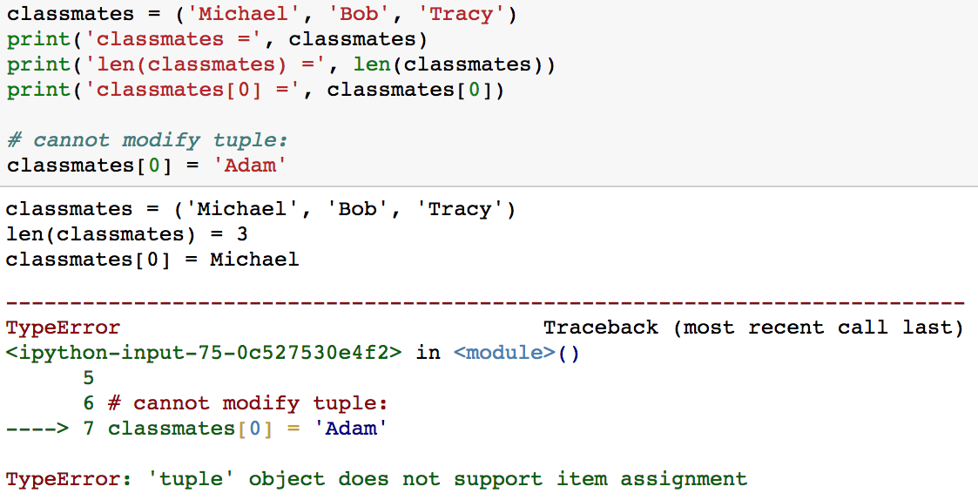
Tuple
A tuple is in many ways similar to a list.
But it is immutable ordered list of values.

Slide 38
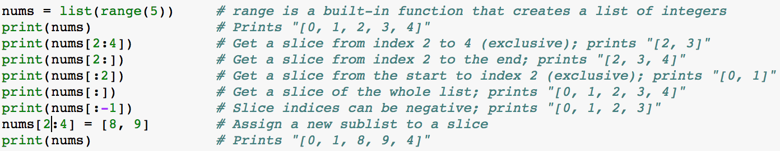
Slicing and Indexing
Slicing: Python provides concise syntax to access sublists.
Range: the range type represents an immutable sequence of numbers
For more, see https://docs.python.org/3.6/library/stdtypes.html?highlight=range#range

Slide 40
Python Dictionary
A dictionary stores unordered (key, value) pairs.
Search and Insert elements fast.
key is immutable.
More than one entry per key is not allowed.
For more, see https://www.tutorialspoint.com/python3/python_dictionary.htm

Slide 42
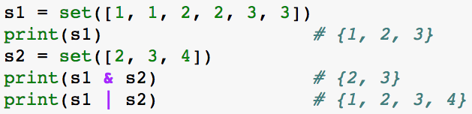
Set
A set is an unordered collection of distinct elements (same as the corresponding concepts in math)

Slide 43
Python Control Flow
Anyone wanna go for lunch? If not, I’ll ask again later.

Slide 44
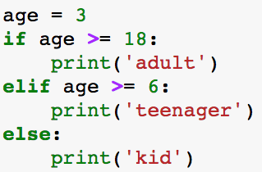
Conditional Statement
Test if a Boolean expression is True or False and run different code in each case
Can split the code into more than two cases

Slide 45
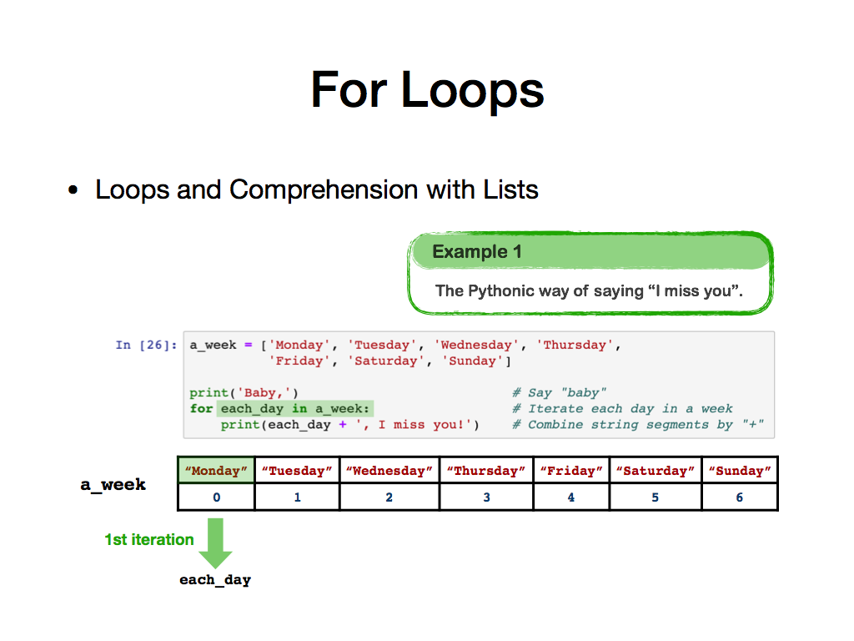
For Loops
Loops and Comprehension with Lists

Slide 46
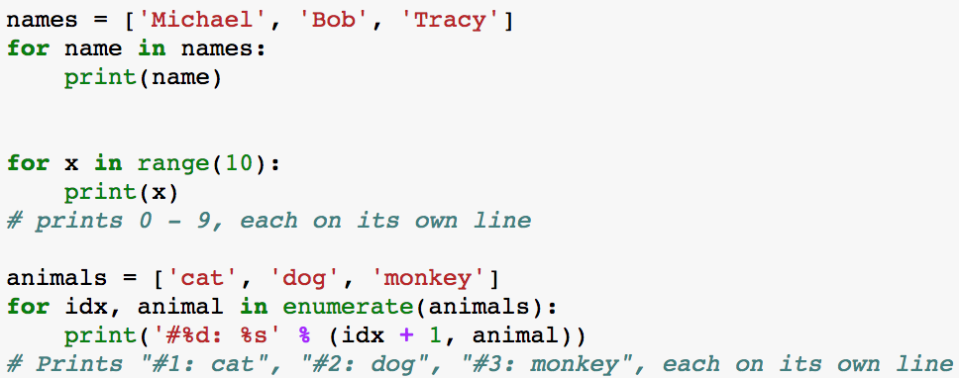
For Loops
More examples

Slide 47
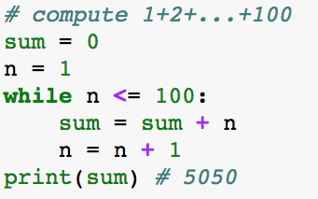
While Loops
You can also use while to loop
For more, see https://www.tutorialspoint.com/python3/python_loops.htm

Slide 48
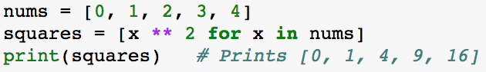
List Comprehension
To transform one type of data into another easily.
Instead of using loops, we can write
You can add conditional control

Slide 49
Functions

Slide 50
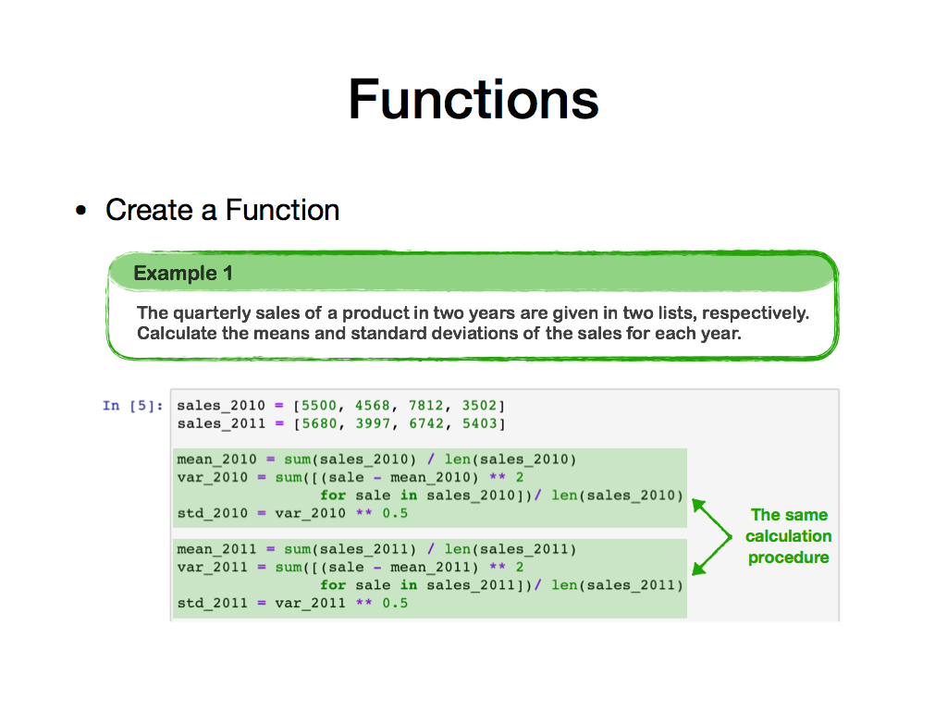
Function
Create a function

Slide 51
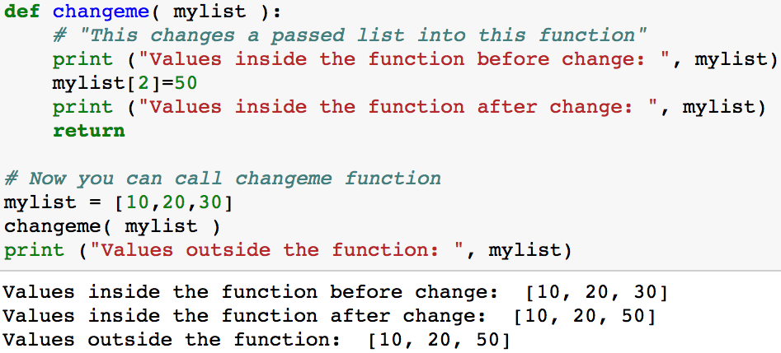
Passing by Reference
All parameters (arguments) in Python are passed by reference. It means if you change what a parameter refers to within a function, the change also reflects back in the calling function.

Slide 52
Passing by Reference
All parameters (arguments) in Python are passed by reference. It means if you change what a parameter refers to within a function, the change also reflects back in the calling function.

Slide 53
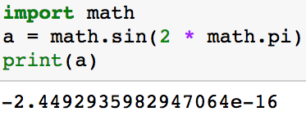
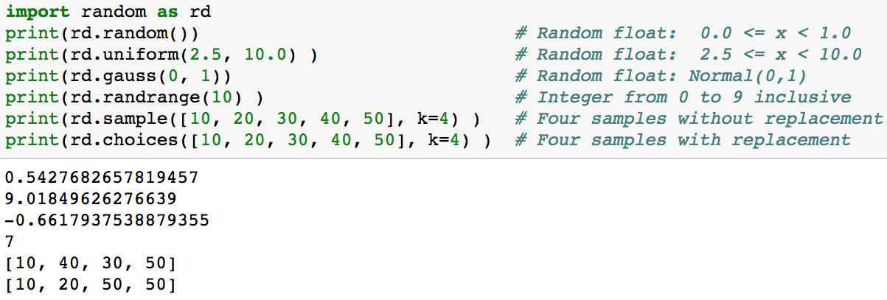
More Examples of Function from Modules
math
random

Slide 54
Vector, Matrix, and Array
For Linear Algebra use, you need to install and import numpy module.
Slicing and transpose
Basic vector and matrix operation
Basic Linear Algebra
To learn numpy, you are encouraged to read the tutorial:
http://cs231n.github.io/python-numpy-tutorial/
https://docs.scipy.org/doc/numpy/user/quickstart.html

Slide 55
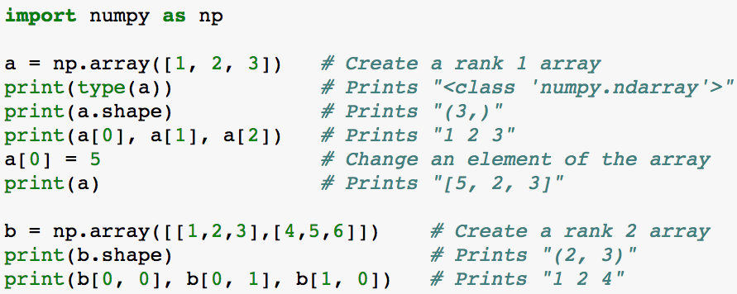
Basic Initialization

Slide 56
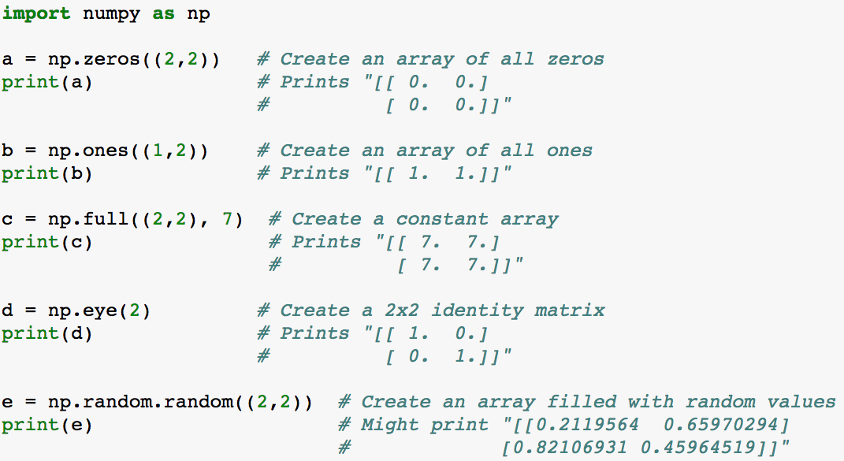
Special Initialization

Slide 57
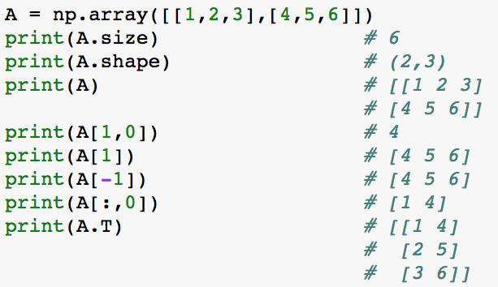
Slicing and Transpose

Slide 58
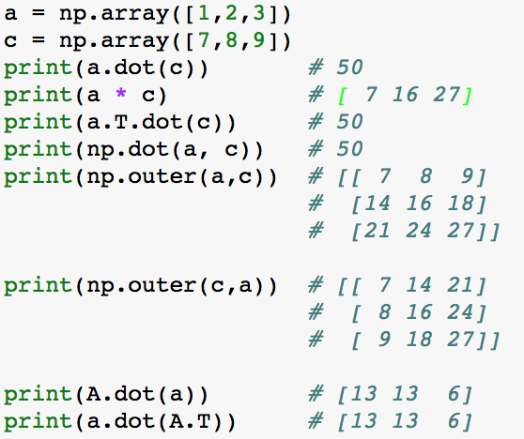
Vector and Matrix Multiplication
n-dim vectors are NOT 1xn or nx1 matrices and can be either column or row vectors

Slide 59
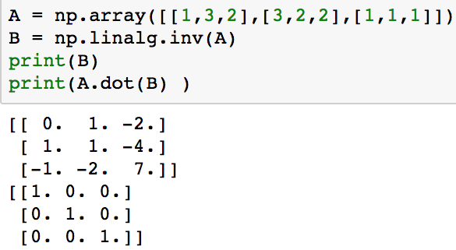
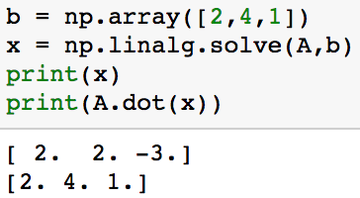
Basic Linear Algebra
Matrix Inverse
Solve linear systems

Slide 60
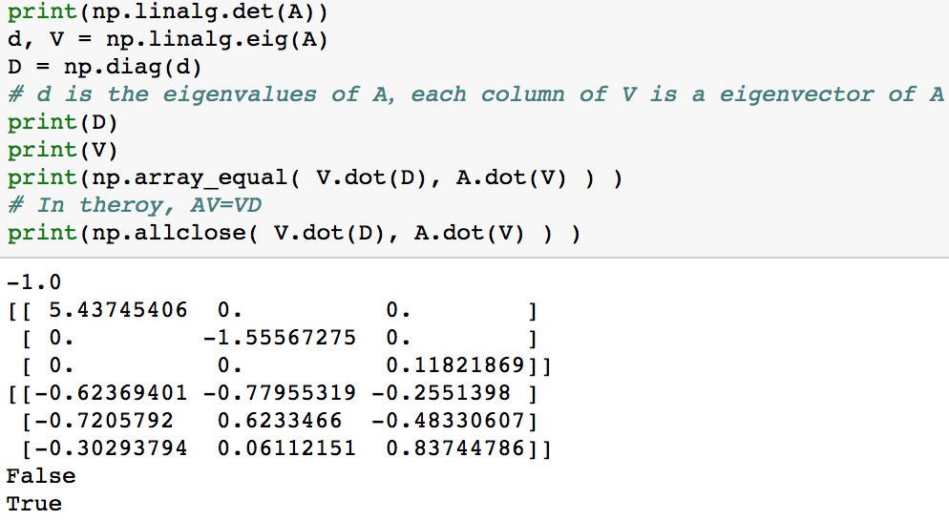
Basic Linear Algebra
Get determinant, eigenvalues and eigenvectors

Slide 61
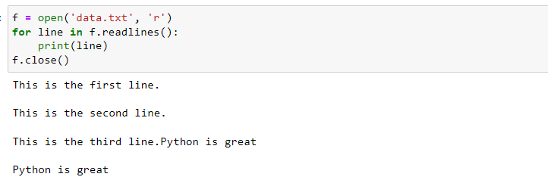
File Input/Output
First, open a file by open()
Then, read the file:
For small file, we can use read() to read the file in a batch
For large file, we can use read(size)
readline() read a line each time
Finally, use close() to close the file

Slide 62
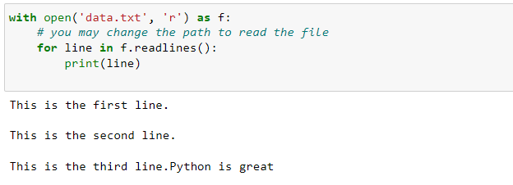
File Input/Output
Using the with keyword when dealing with file objects is highly suggested.

Slide 63
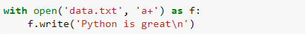
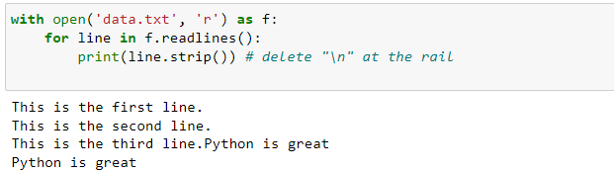
File Input/Output
Add contents at the end of the file. Notice the argument is a ‘a+’.
If you want to rewrite the file from the beginning, use ‘w’ or ‘r+’. For more details, see
https://www.tutorialspoint.com/python3/python_files_io.htm
https://docs.python.org/3.6/tutorial/inputoutput.html

Slide 64
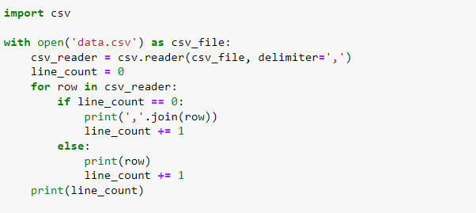
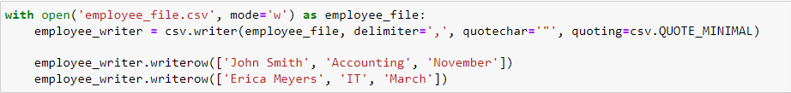
File Input/Output
Read CSV file
Write CSV file

Slide 65
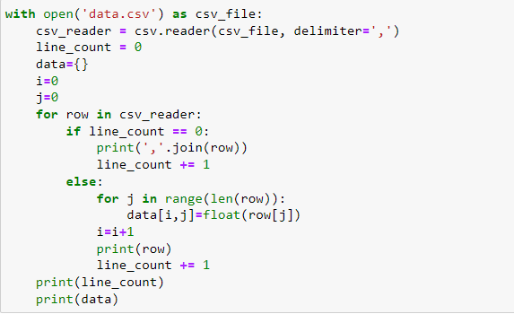
File Input/Output
Read CSV data as Dictionary

